Slide 1
We Work Safely Building the Foundation for a Strong HSE Culture
Notes:
We Work Safely
Put Safety First

Slide 2
Safety Performance and Cultural Drivers
We are not safe enough
LTCR 0,8
Severity rate 22,5
Over 4200 Lost Days
Risk Level 16.2
One fatality
(2025 data)
We normalize lower safety standards
Practices are often accepted as ‘good enough’, despite not being fully risk assessed, resulting in routine work that exposes people to risk.
We are driving out culture
Safety culture mirrors leadership habits:
What we ask about
What we look at
What we stop
What we reward
What we tolerate

Slide 3
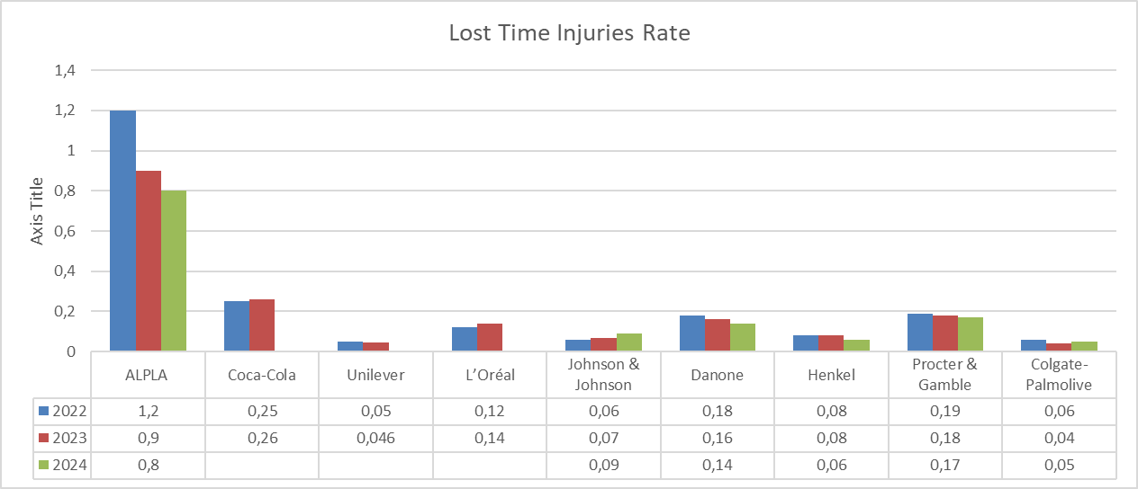
Lost Time Injuries Frequency

Slide 4

Key Levers to Strengthen Safety Culture
1) Establish the HSE Foundation
Ensure full implementation of HSE standards across all plants
Drive consistent application in daily work, not only on paper
Unsafe practices are not acceptable, even if they are common or “how we do it today”
2) Strengthen HSE Competence
Leaders at all levels understand the hazards and risks in their area
Leadership is visible and engaged, setting the example for safe behavior
Ensure access to qualified HSE expertise, appropriate to the size and risk profile of each operation
3) Make Risk‑Informed Decisions Daily – big or small
Avoid trading controls for output or speed
Know the hazard - Identify sources of harm in the task
Understand exposure - Who is exposed, when, and how
Assess and reduce the risk - Apply controls that keep work stable and safe
Where leadership focus creates the strongest impact on safety performance

